Slide 1

Repeated Elements
(Loops)

Slide 2
Repetition: The need for Looping Constructs
Consider pseudo code to define the assessment of a test paper submitted by a member of Class 4C of the year 1981.
But … what if TWO of them turn up on a test day!!!??
Pick up Test Paper
Disinfect
Ready the Red pencil
Read – Interpret where possible
Strike out unflattering representations of myself!
Strike out all libellous (though probably accurate) references to the recreational activities of one’s colleagues
In the unlikely circumstance that anything remains unstruck, seek reference to a pearl of wisdom I might have cast
Add 3 marks for correctly spelled name (a feat occasionally achieved by the students “D. Duck” and “M. Mouse”, but few others)
Weep a while …
Weep some more …
Write “D” on the top of the paper
Discard stump of Red pencil
Pick up Test Paper
Disinfect
Ready the Red pencil
Read – Interpret where possible
Strike out unflattering representations of myself!
Strike out all libellous (though probably accurate) references to the recreational activities of one’s colleagues
In the unlikely circumstance that anything remains unstruck, seek reference to a pearl of wisdom I might have cast
Add 3 marks for correctly spelled name (a feat occasionally achieved by the students “D. Duck” and “M. Mouse”, but few others)
Weep a while …
Weep some more …
Write “D” on the top of the paper
Discard stump of Red pencil

Slide 3
Repetition: The need for Looping Constructs
Or even FOUR of them!!!!
OR …. ALL of them – not that I was ever really sure how many there was supposed to be?
Wonderful! … but what an ugly description of such a simple task!
Mark a 4C Test Paper
Mark a 4C Test Paper
Mark a 4C Test Paper
Mark a 4C Test Paper
Mark a 4C Test Paper
Mark a 4C Test Paper
Mark a 4C Test Paper
Mark a 4C Test Paper
Mark a 4C Test Paper
Mark a 4C Test Paper
Mark a 4C Test Paper
Mark a 4C Test Paper
Mark a 4C Test Paper
Mark a 4C Test Paper
Mark a 4C Test Paper
Mark a 4C Test Paper
Mark a 4C Test Paper
Mark a 4C Test Paper
Mark a 4C Test Paper
Mark a 4C Test Paper
Mark a 4C Test Paper
Mark a 4C Test Paper
Mark a 4C Test Paper
Mark a 4C Test Paper
Mark a 4C Test Paper
Mark a 4C Test Paper
Mark a 4C Test Paper
Mark a 4C Test Paper
.
.
.
.
.
.
.
.
.
.
.
.

Slide 4
Repetition: The need for Looping Constructs
Mindless duplication of the definition of a task that needs to be repeated works.
However, it is the most stupid of the ways to construct a definition of a task that needs to be executed repeatedly.
Far better to surround a single specification of the task to be repeated with some form of Repetition (or Looping) Construct.
There are three obvious ways to arrange such a Looping Construct

Slide 5
Repetition: By counting
1: Count the number of papers presented for assessment. For each, mark it. Stop when the expected number of papers have been processed.
Pseudo-code
Count the papers to be assessed.
For each test paper, starting with the first, continuing until the final paper and omitting none:
Mark a 4C Test Paper
Note: You need to know the total number of papers to be marked ahead of execution of the Loop, if you wish to use this approach.
I counted, there were 43!! 4C was a well populated class.

Slide 6
Repetition: ”Test at the Top” Loop
2: Test for the existence of unmarked papers, While any exists, mark one, otherwise finish.
Pseudo-code
Look for papers still to be assessed.
While papers remain to be marked.
Mark a 4C Test Paper
The test that determines whether the Loop is entered or not is before any paper is marked. The test is at the TOP of the Loop.
Were there no papers in the first place, this approach would just do nothing.

Slide 7
Repetition: ”Test at the Bottom” Loop
3: After marking each paper, test for the existence of more unmarked papers. Repeat marking papers until there are not more to mark.
Pseudo-code
Mark a 4C Test Paper
Look for papers still to be assessed.
Repeat marking papers Until no more remain to be marked.
The test that determines whether the Loop is continued or not is after each paper is marked. The test is at the BOTTOM of the loop.
Were there no papers in the first place, this approach could get a bit confused!

Slide 8
Repetition: Implementation
Many Programming Languages, including Python, do not offer a ready made code block for all three types of Loop.
Counting (or For) Loops, and Test at the Top (or While) Loops are generally available.
Test at the Bottom (or Repeat … Until) Loops are generally not.
It is trivial to restate a Test at the Bottom Loop as a Test at the Top Loop, so most would argue, this is not a serious omission.
Language simplification is purchased at the cost of less beautiful code.

Slide 9
Repetition: Implementation
Consider this simplified pseudo code for the Test at the Bottom Loop of a slide or two back.
Pseudo-code
Mark a 4C Test Paper
Repeat … Until no more remain to be marked.
And now a version using a Test at the Top Loop with exactly the same effect.
Pseudo-code
While Lisboa is to the South of Porto
Mark a 4C Test Paper
If last paper, Exit Loop
Essentially, a While Loop controlled with a condition that is always True.
Plus an explicit Extra Conditional at the bottom to ensure the While Loop does not continue forever, but ends at the logically appropriate moment.
OK, that works … but where is the poetry!!!! Can you say the “solution” now melds seamlessly with the problem? … I retreat in distress!

Slide 10
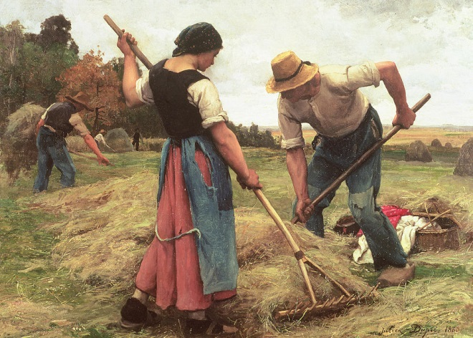
Repetition: A Real Life Example
The daily schedule of
a busy Farmer
Arise at crack of Noon
Kick a Cat
While there are cats to kick
While Loops
(Test at the Top)
Make Hay
While the sun shines
For Loop
(Count the Repeats)
Feed a Cow
For each of 10 Hungry Cows
Repeat Loop
(Test at the Bottom)
Count a sheep
Repeat until asleep
Notes:
A quick look at the concetual range of loops
By example of a day in the life of a, somewhat inadequate, farmer.
First consider the day as a series of activiites.
Then note that ALL cats should be kicked. One cannot predict the number of cats that can be kicked as they move pretty fast and cannot be relied upon to be in situ at the right moment. Such is the nature of these creatures.
One can only kick cats while there are cats to be kiicked!
On a bad day, there maybe ZERO cats to be kicked!!! One must test first act later.
……
Make hay whilst the sun shines
Again one tests first
If no sun then no hay making!!
First sign of rain, haymaking stops
When sun goes to bed, haymaking ceases
Again a test and then do if test succeeds loop.
-----
Cows, unlike cats, can be relied upon to be where they should be! …. Usually at least.
This farmer has 10 cows so he can feed/milk them in series stopping when he gets to 10.
A repeated operation controlled by counting. A “for” loop indeed.
----------
Sheep are pretty reliable too, but one can never tell how many one needs to count before one goes to sleep.
However, one always counts at least one! So this is a loop where one tests whether to go on at the bottom. So it is assured that the loop will be enacted at lest once. Unlike Haymaking and cat kicking.
------------------------------------------------------------------------------------------
Of course it can all go wrong
What if the sun don’t shine at all?? And there is no hay to feed the cows?
For example
But … that sounds a bit too close to “Real Life” to worry about here ☺
------------------------------
Finally, one could put the whole day in a loop!
Repeat
Day of farming activities
Until the crack of dawn fails to wake thee

Slide 11
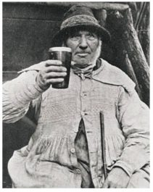
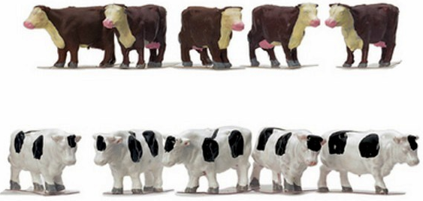
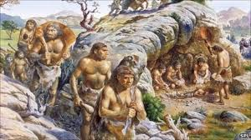
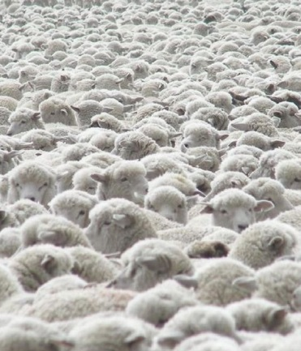
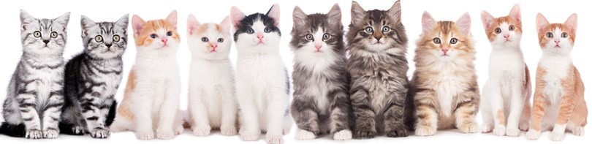
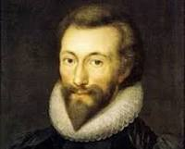
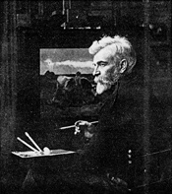
Repetition: Acknowledgements
The Farmer
Ten overfed Cows
4C at play
Many many cats
A sea of sheep
John Heywood, for his poem:
“Whan the sunne shinth make hay. Whiche is to say. Take time whan time cometh, lest time steale away”
Julien Dupré for his
beautiful farm paintings

Slide 12
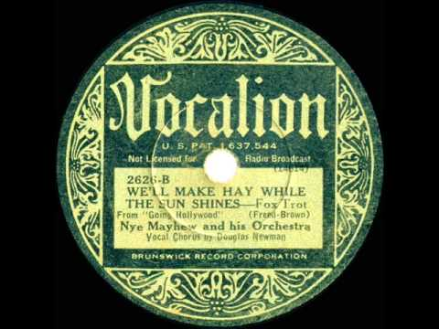
Repetition: Acknowledgements
Nye Mayhew and his Orchestra, Vocalist Douglas Newman, who sing and play for you now.

